Slide 1

A Few Methods to Improve Overfitting
Professor Bo Liu
James Watt School of Engineering

Slide 2
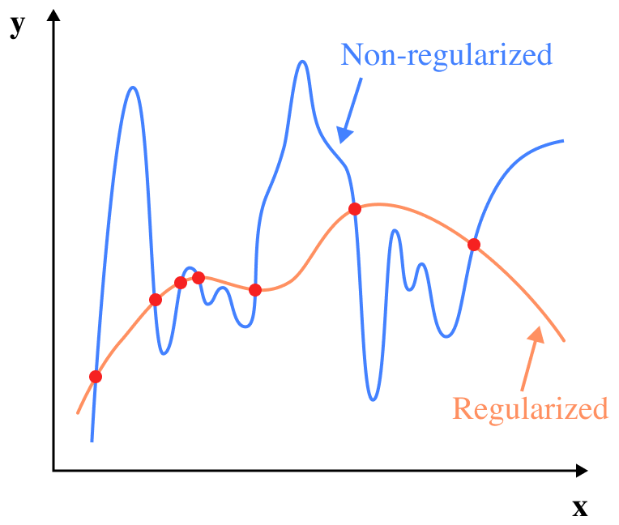
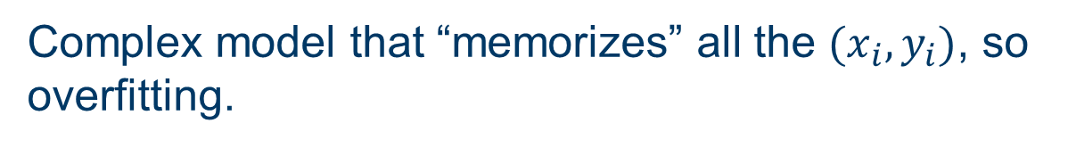
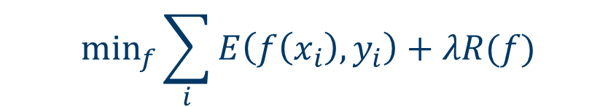
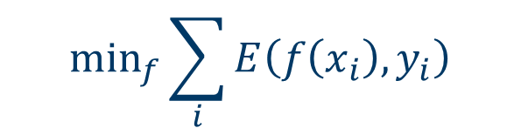
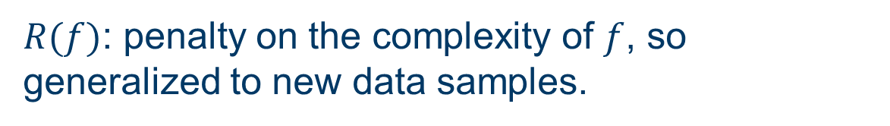
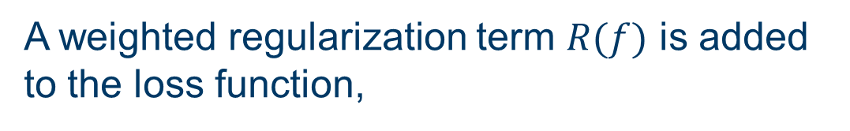
Regularization
A weighted regularization term $R(f)$ is added to the loss function,
$$\min_{f}\sum_{i}{E\left(f\left(x_{i}\right), y_{i}\right)+λR(f)}$$
Useful documentation:
regularization
$E\left(f\left(x_{i}\right), y_{i}\right)$: error function
If without the regularization term, the loss function
$$\min_{f}\sum_{i}{E\left(f\left(x_{i}\right), y_{i}\right)}$$
Complex model that “memorizes” all the $(x_{i}, y_{i})$, so overfitting.
$R(f)$: penalty on the complexity of $f$, so generalized to new data samples.
What regularization does to a function y=f(x)

Slide 3

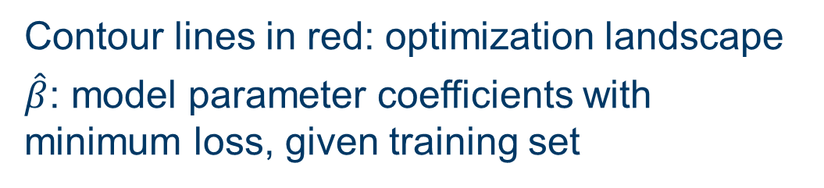
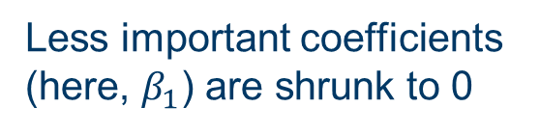

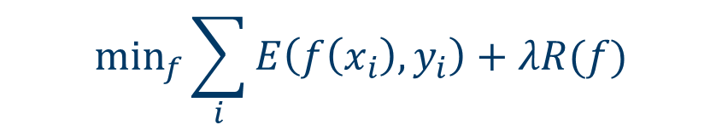
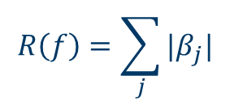

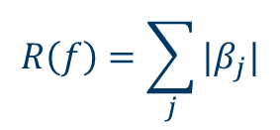

L1 Regularization
$R(f)$: penalty on the complexity of $f$, so generalized to new data samples.
L1 regularization, a.k.a. Lasso regression:
$$R\left(f\right)=\sum_{j}{|β_{j}|}$$
Minimize the penalized loss function,
$$R\left(f\right)=\sum_{j}{|β_{j}|}$$
$$β_{2}$$
$$\hat{β}$$
$β$: model parameter coefficients
$$\left|β_{1}\right|+\left|β_{2}\right|≤s$$
$$\min_{f}\sum_{i}{E\left(f\left(x_{i}\right), y_{i}\right)+λR(f)}$$
$$β_{1}$$
Contour lines in red: optimization landscape
$\hat{β}$: model parameter coefficients with minimum loss, given training set
Less important coefficients (here, $β_{1}$) are shrunk to 0

Slide 4

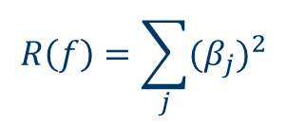



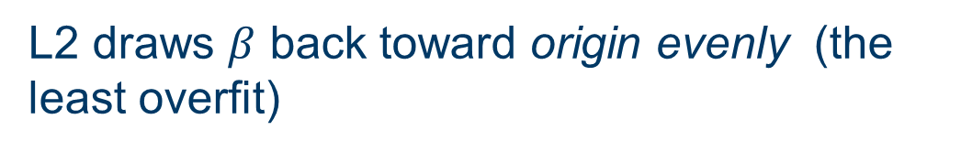
L2 Regularization
$R(f)$: penalty on the complexity of $f$, so generalized to new data samples.
L2 regularization, a.k.a. Ridge regression:
$$R\left(f\right)=\sum_{j}{{(β_{j})}^{2}}$$
$β$: model parameter coefficients
$$β_{2}$$
$$\hat{β}$$
L2 draws $β$ back toward origin evenly (the least overfit)
$$β_{1}^{2}+β_{2}^{2}≤s$$
$$β_{1}$$

Slide 5
Training-validation-test splitting
Evaluate the model while training:
ML model
Used for training
model parameters
Training set
Training set
Used for evaluating
model while training
Validation set
Test set
Used for final testing
Test set
Full dataset
Training-validation-test splitting
Training-test splitting
Randomly sampled
Stop the training when validation error remains unchanged or goes up

Slide 6
Overfitting - training curve
Early-stopping, by learning curve of the validation set
Underfitting
Overfitting
Validation set
Loss
Some common splitting ratios (training : validation : test)
8:1:1 7:1.5:1.5 6:2:2 7:2:1
Training set
Epochs
Early stopping
The model parameter update stops at the minimum validation loss.

Slide 7




Thanks!
#UofGWorldChangers
@UofGlasgow

